Slide 1
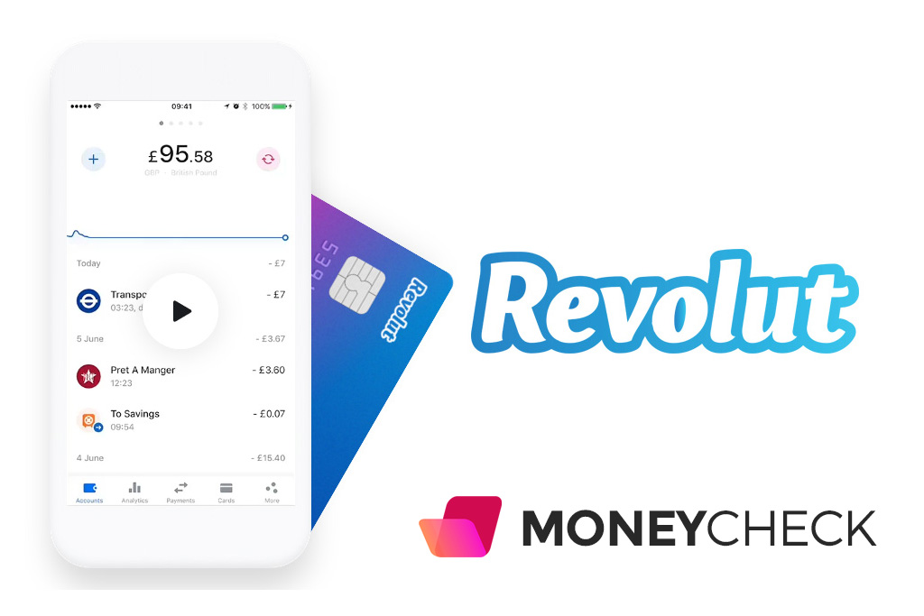
TEAM 2
Student 1: id 555555
Student 2: id 666666
Student 3: id 777777
Student 4: id 888888

Slide 2

AGENDA
Company Background
Market Opportunity
FinTech…
Business Model.
Competitive Analysis
Data Analytics—Fraud Detection
Q&A

Slide 3
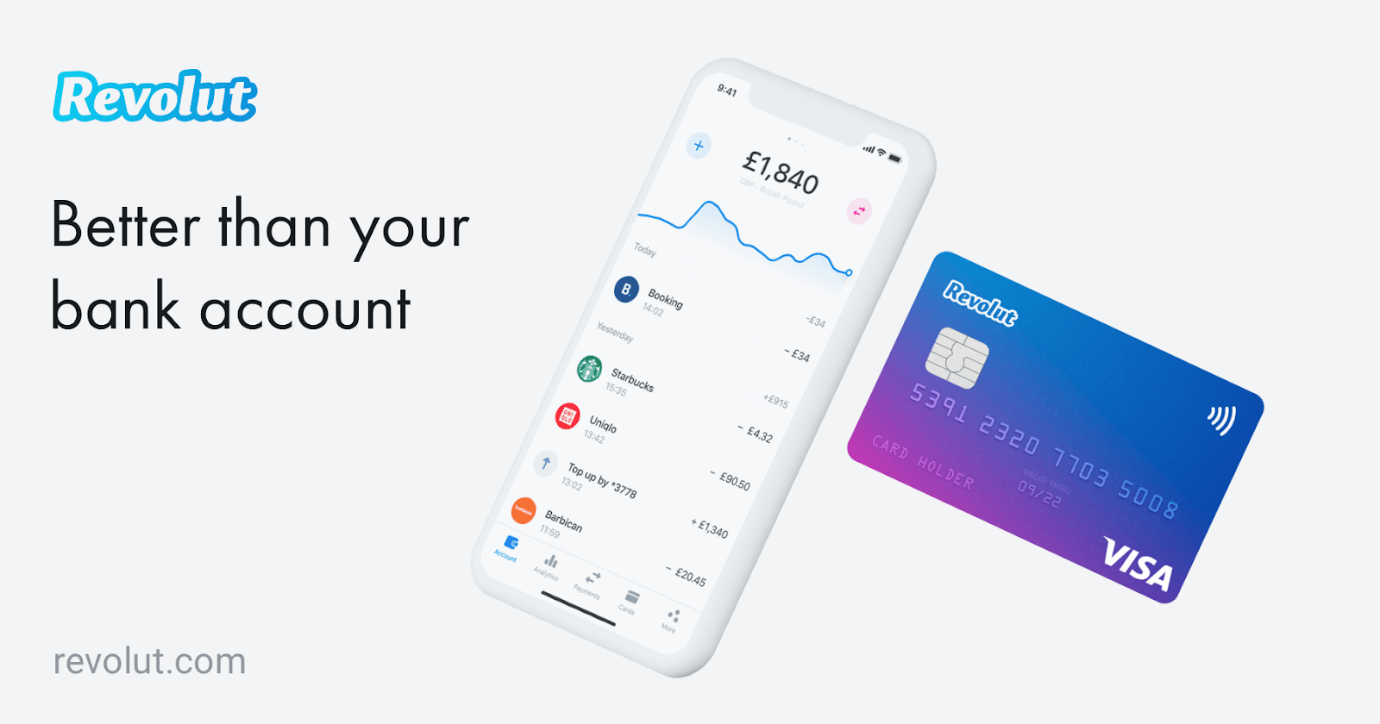

Background
Revolut Ltd, founded in 2015, is a UK financial technology company that offers digital banking services including prepaid debit card, cryptocurrency exchange, P2P payments, and most important, the currency exchange.
Revolut focused first on disrupting the lucrative international transactions market by removing the hefty hidden fees and the clients have traditionally paid on international transactions (e.g. Exchange Store).
And this company has disrupted this space by offering a frictionless payment platform that cuts hidden fees and offers interbank currency rates in 150 currencies.

Slide 4
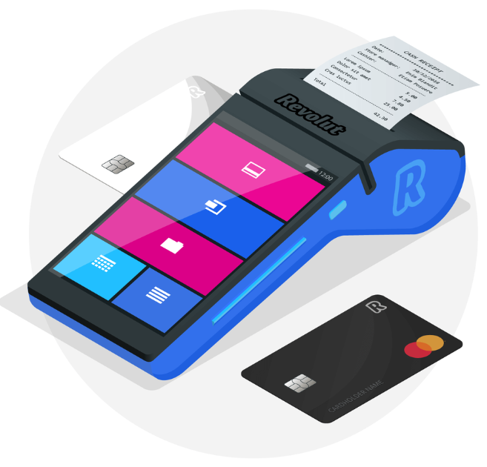
Spend abroad with no fees in over 130 currencies with a contactless MasterCard or Visa
Hold and exchange 25 currencies at spot rates in the app
Free domestic and international money transfers
CHF 200 per month of free international ATM withdrawals with a 2% fee thereafter
Instant spending notifications, spending categorization and budgeting controls
Enhanced security with instant and free function to enable and disable the card
Short-term device-, travel- and medical insurance
Instant credit to your account in 2 minutes worldwide
The Revolut Offering In Short

Slide 5
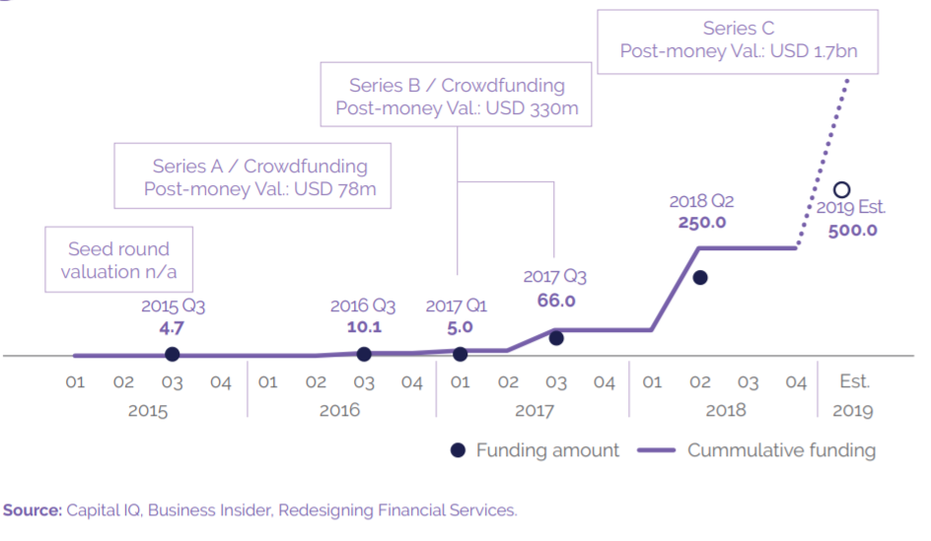
Revolut’s funding and valuation history
(USD millions)
(USD millions)

Slide 6
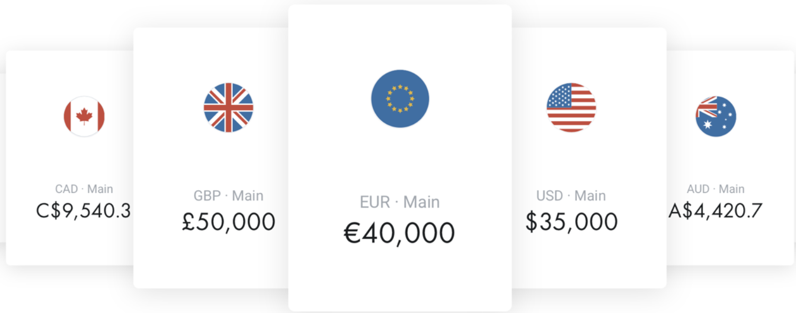
2. Market Opportunity
Revolut’s goal is to act as a banking alternative to people and businesses.
Pain Points
The global financial system relies on a network of different payments systems, some of which are pretty old. They spend a lot of time moving numbers around.
Bank clients still pay their banks 3%-6% in fees for their foreign transactions. These fees are made up of a small transaction fee, but also of a larger (but hidden) spread between the spot exchange rate and the rate offered by the provider.
Revolut identified key pain points of clients caused by traditional global banking system, understands how important it is for international businesses to save on transfer costs and send global payments fast.

Slide 7

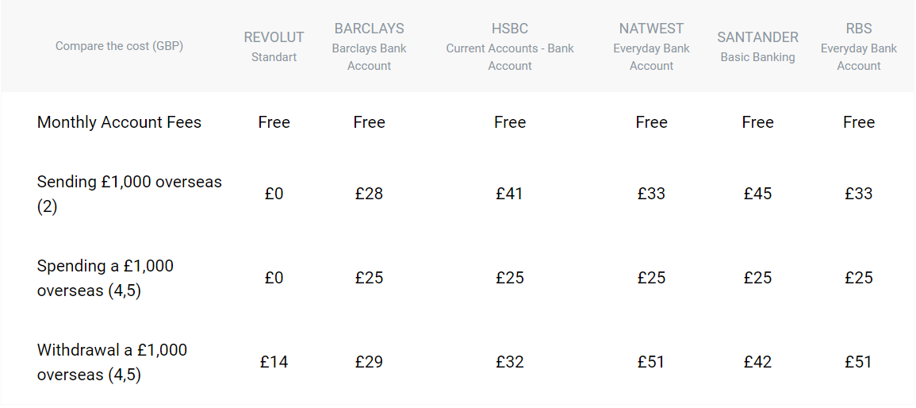
The Eurozone (GBP/EUR) (1)
When you spend or transfer money abroad, your bank usually charges you a fee. These fees are often hidden in exchange rate markups or charged automatically when you pay, which makes it hard to work out how much you’re being charged.

Slide 8
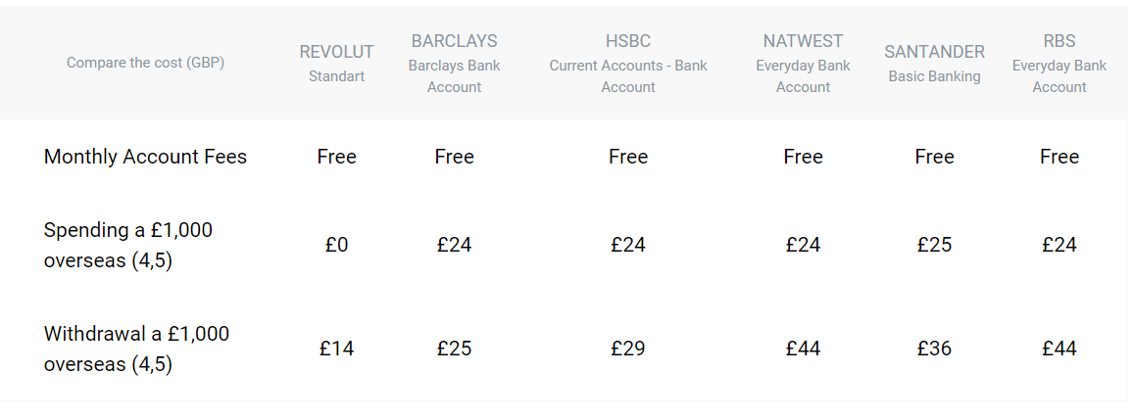
The USA (GBP/USD) (2)
When you spend or transfer money abroad, your bank usually charges you a fee. These fees are often hidden in exchange rate markups or charged automatically when you pay, which makes it hard to work out how much you’re being charged.

Slide 9
Exchange Rate Difference(3)
If all the users don’t subscribe its premium accounts, Revolut may lose £25B(transaction volume) * 4%(estimate ex-rate difference) = £1B revenue. To cover such a great difference, Revolut may need 12M users for PREMIUM account or 6.4M for Metal account.
Bank/1GBP | EUR | USD | EUR diff | USD diff
HSBC UK | 1.1126 | 1.2577 | 4.09% | 3.99%
NATWEST | 1.1095 | 1.2578 | 4.35% | 3.98%
BARCLAYS | 1.1001 | 1.2534 | 5.16% | 4.32%
RBS | 1.11 | 1.26 | 4.31% | 3.82%
Market | 1.16 | 1.31 | 4.48%(AVG) | 4.03% (AVG)

Slide 10

3. Competitive Analysis
Comparison : Traditional Human Advisor
Historically, there’s been a couple of major ways you could invest your money:
Do it yourself. Which means you would need to do tons of research into stocks, ETFs, bonds etc.
Turn to the investment managers for help. Buy mutual funds or an investment insurance where you would essentially pay an investment manager to do the same with fees that are often 2% or more!
Robo-advisors are computer programs that will collect some information about you .Once you put your money in, they will automatically invest it on your behalf and since there’s no human intervention, they can cut costs and make management fees much lower for the consumers!

Slide 11
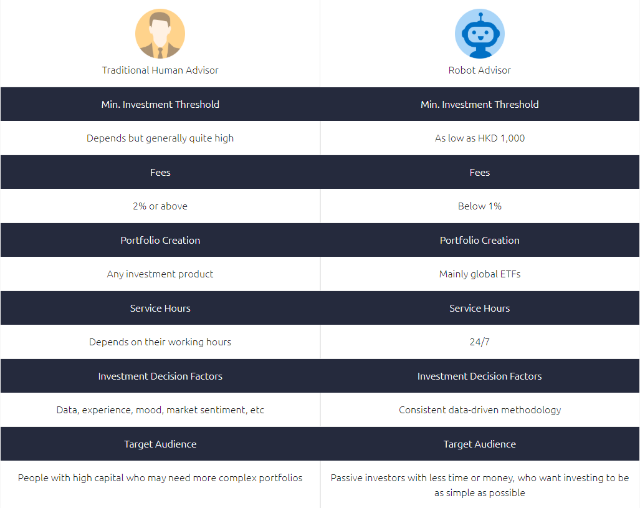

Slide 12



Comparison : Robo-Advisors in HK
Category | AQUMON | Kristal.ai | SoFi Hong Kong (Chloe)
Fees(annual) | 0.4% | 0% | 0%
Min Investment Amount | HK$7,800 | HK$1,000 | HK$1,000
Target Market | HK & US | HK & US | HK
Investment Asset | ETF (stocks, bond, oil/gold) | ETF (stocks, bond),REITs | ETF (stocks, bonds)
Rebalance Frequency | Quarterly/Monthly | Every six months | Irregular adjustment
Employees number | 40 (3% up) | 1634 (1% up) | 85 (5% up)
Employee rating | 4.2 | 3.3 | 4.6

Slide 13




Strong past performance (> 20% in 2019) and high transparency
All ETFs in the portfolio are carefully analyzed and selected
Easy to use app. Even if you have no accounts, the app has useful information on how to start investing
Uses US ETFs which charge lower fees
PROS
CONS
Minimum investment amount is slightly higher than other robo-advisors

Slide 14

Business Model
Accounts Subscription Fees.
Additional Revolut Card Charges
Transaction Charges(over £5000)
The Exchange Rates

Slide 15

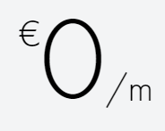
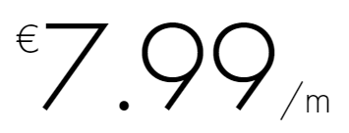
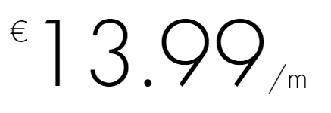
4.1 Subscription Fees
80%
STANDARD
PREMIUM
METAL
Free UK current account
Free Euro IBAN account
Spend in over 150 currencies at the interbank exchange rate
Unlimited exchange in 24 fiat currencies - no monthly limit
No fee ATM withdrawals up to €600 per month
Overseas medical insurance
Delayed baggage & delayed flight insurance
Global express delivery
Priority customer support
Instant access to 5 cryptocurrencies
Exclusive concierge service
Exclusive Revolut Metal card
Disposable virtual cards
Up to 0.1% cashback within Europe and up to 1% outside Europe on all card payments
Free UK current account
Free Euro IBAN account
Spend in over 150 currencies at the interbank exchange rate
No fee exchange in 24 fiat currencies up to€6,000 per month
No fee ATM withdrawals up to €200 per month
Free UK current account
Free Euro IBAN account
Spend in over 150 currencies at the interbank exchange rate
Unlimited exchange in 24 fiat currencies - no monthly limit
No fee ATM withdrawals up to €400 per month
Overseas medical insurance
Delayed baggage & delayed flight insurance
Global express delivery
Priority customer support
Instant access to 5 cryptocurrencies
Premium card with exclusive designs
Disposable virtual cards
Notes:
Unlimited transaction, medical insurance, most importantly access to cryptocurrencies

Slide 16
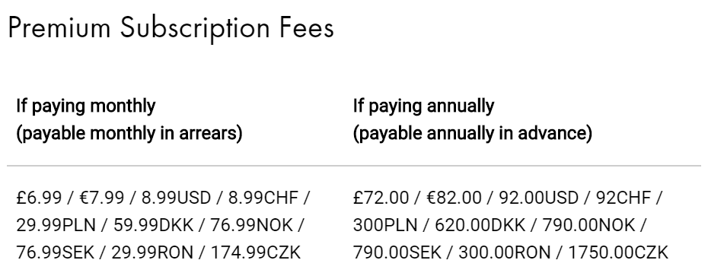

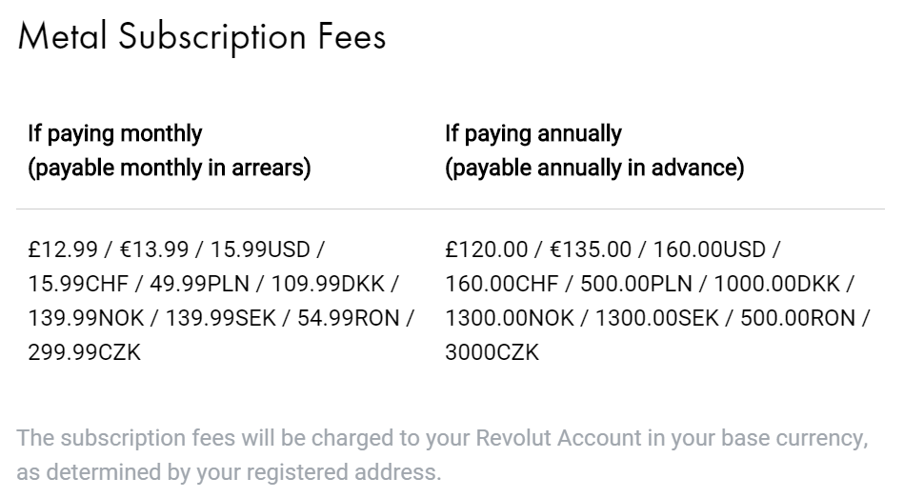

4.2 Subscription Fees
Annually?
Monthly?

Slide 17
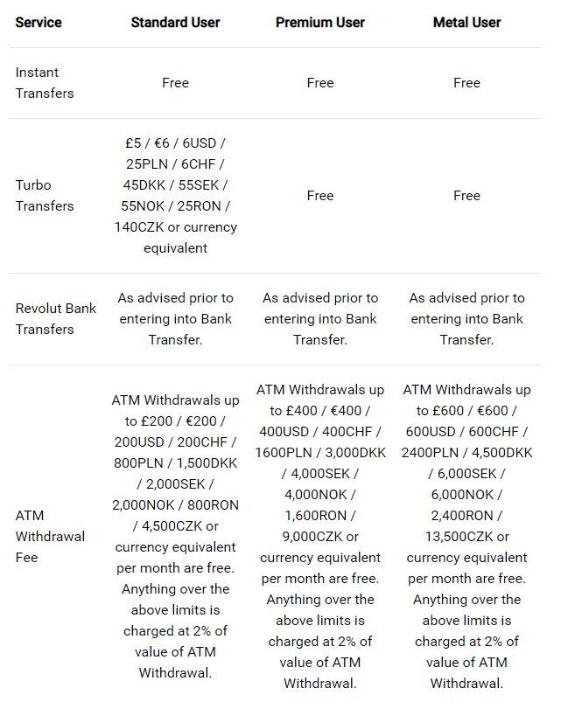
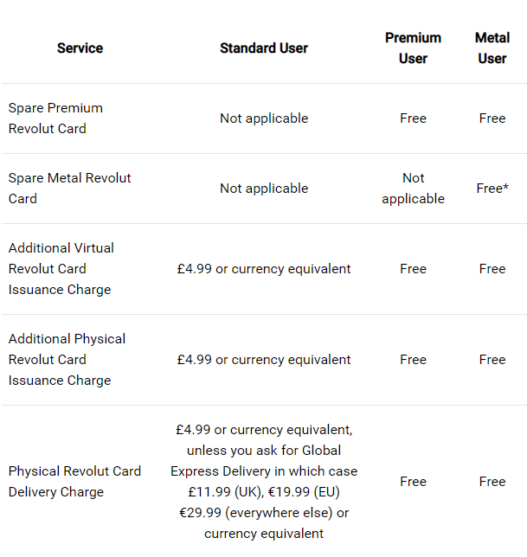
4.3 Other Charges
Additional Revolut Card Charges
Transaction Charges

Slide 18
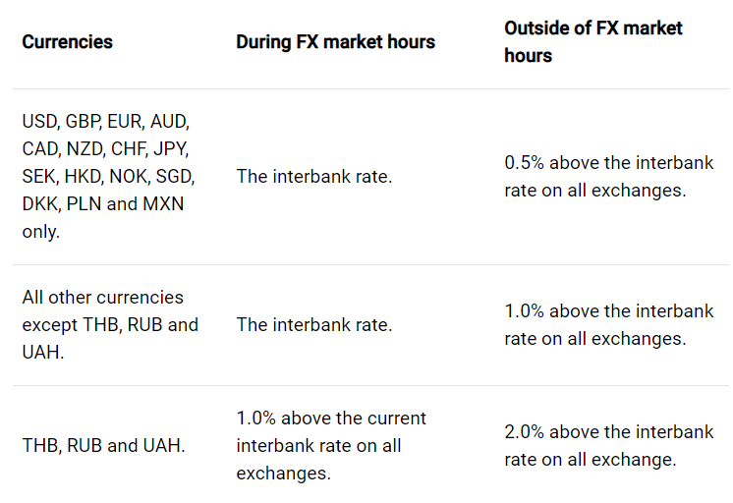
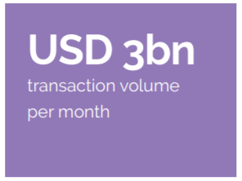
4.4 The Standard Exchange Rates
“Revolut saves clients up to 6% of their purchases in foreign currencies, because it offers clients access to the spot rates for foreign exchange transactions and charges them zero for transfers.”

Slide 19

5. Data
Analytics

Slide 20
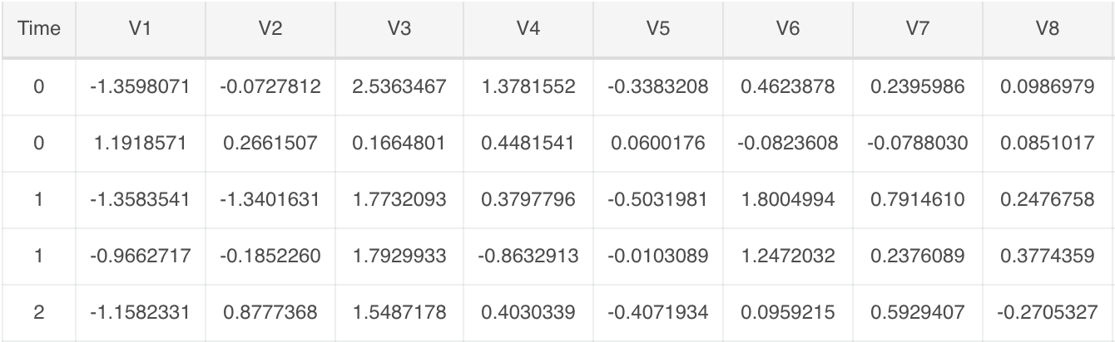
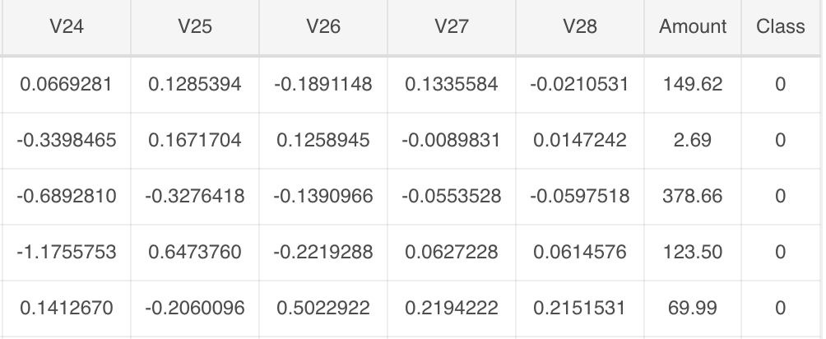
5.1 Data Preparation
Dataset: 284,807 transaction records with 492 frauds and 284315 normal customers
Features: V1, V2, ... V28 are the principal components obtained with PCA, the only features which have not been transformed with PCA are 'Time' and 'Amount'.
Feature 'Class' is the response variable and it takes value 1 in case of fraud and 0 otherwise.

Slide 21
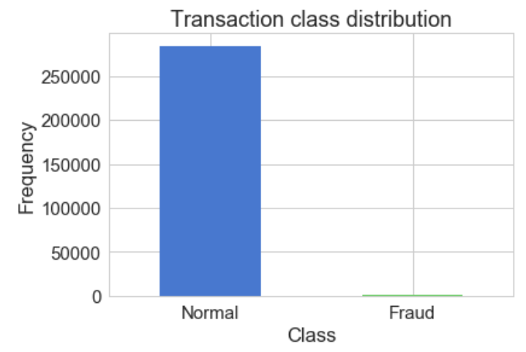
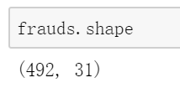
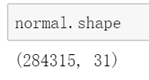
5.2 EDA
Heavily imbalanced dataset! → Oversampling
SMOTE — Synthetic Minority Over-sampling Technique
Finding the k-nearest-neighbors for minority class observations (finding similar observations)
Randomly choosing one of the k-nearest-neighbors and using it to create a similar, but randomly tweaked, new observations.

Slide 22
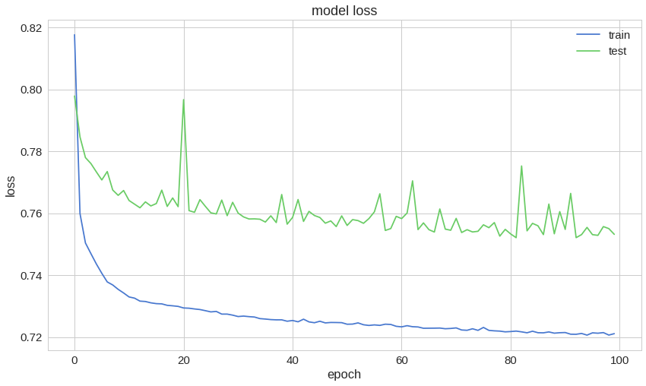
5.3 Train Model
The reconstruction error on our training and test data seems to converge nicely

Slide 23
5.4 Demo Video a long video provided here to illustrate the analytics

Slide 24
Thank You
Team 2

Slide 25
---------------------------------------------------------

Slide 26
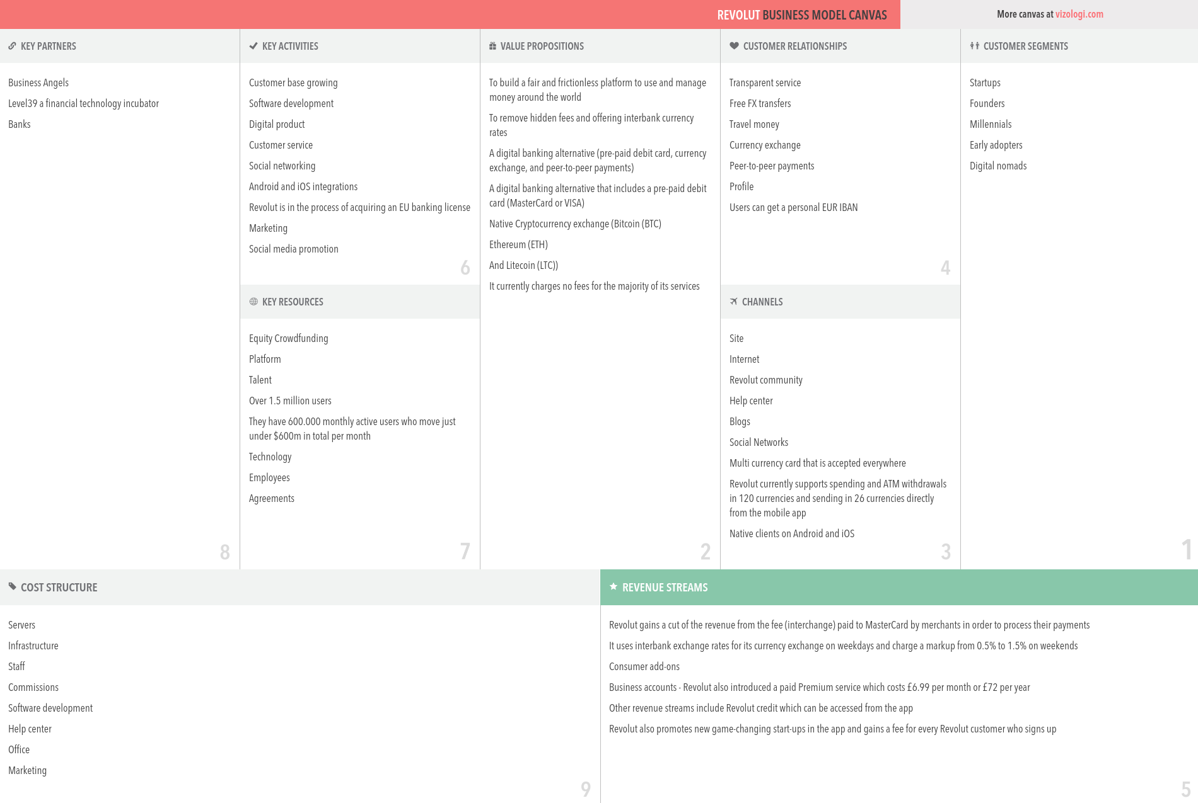
Business
Canvas

Slide 27
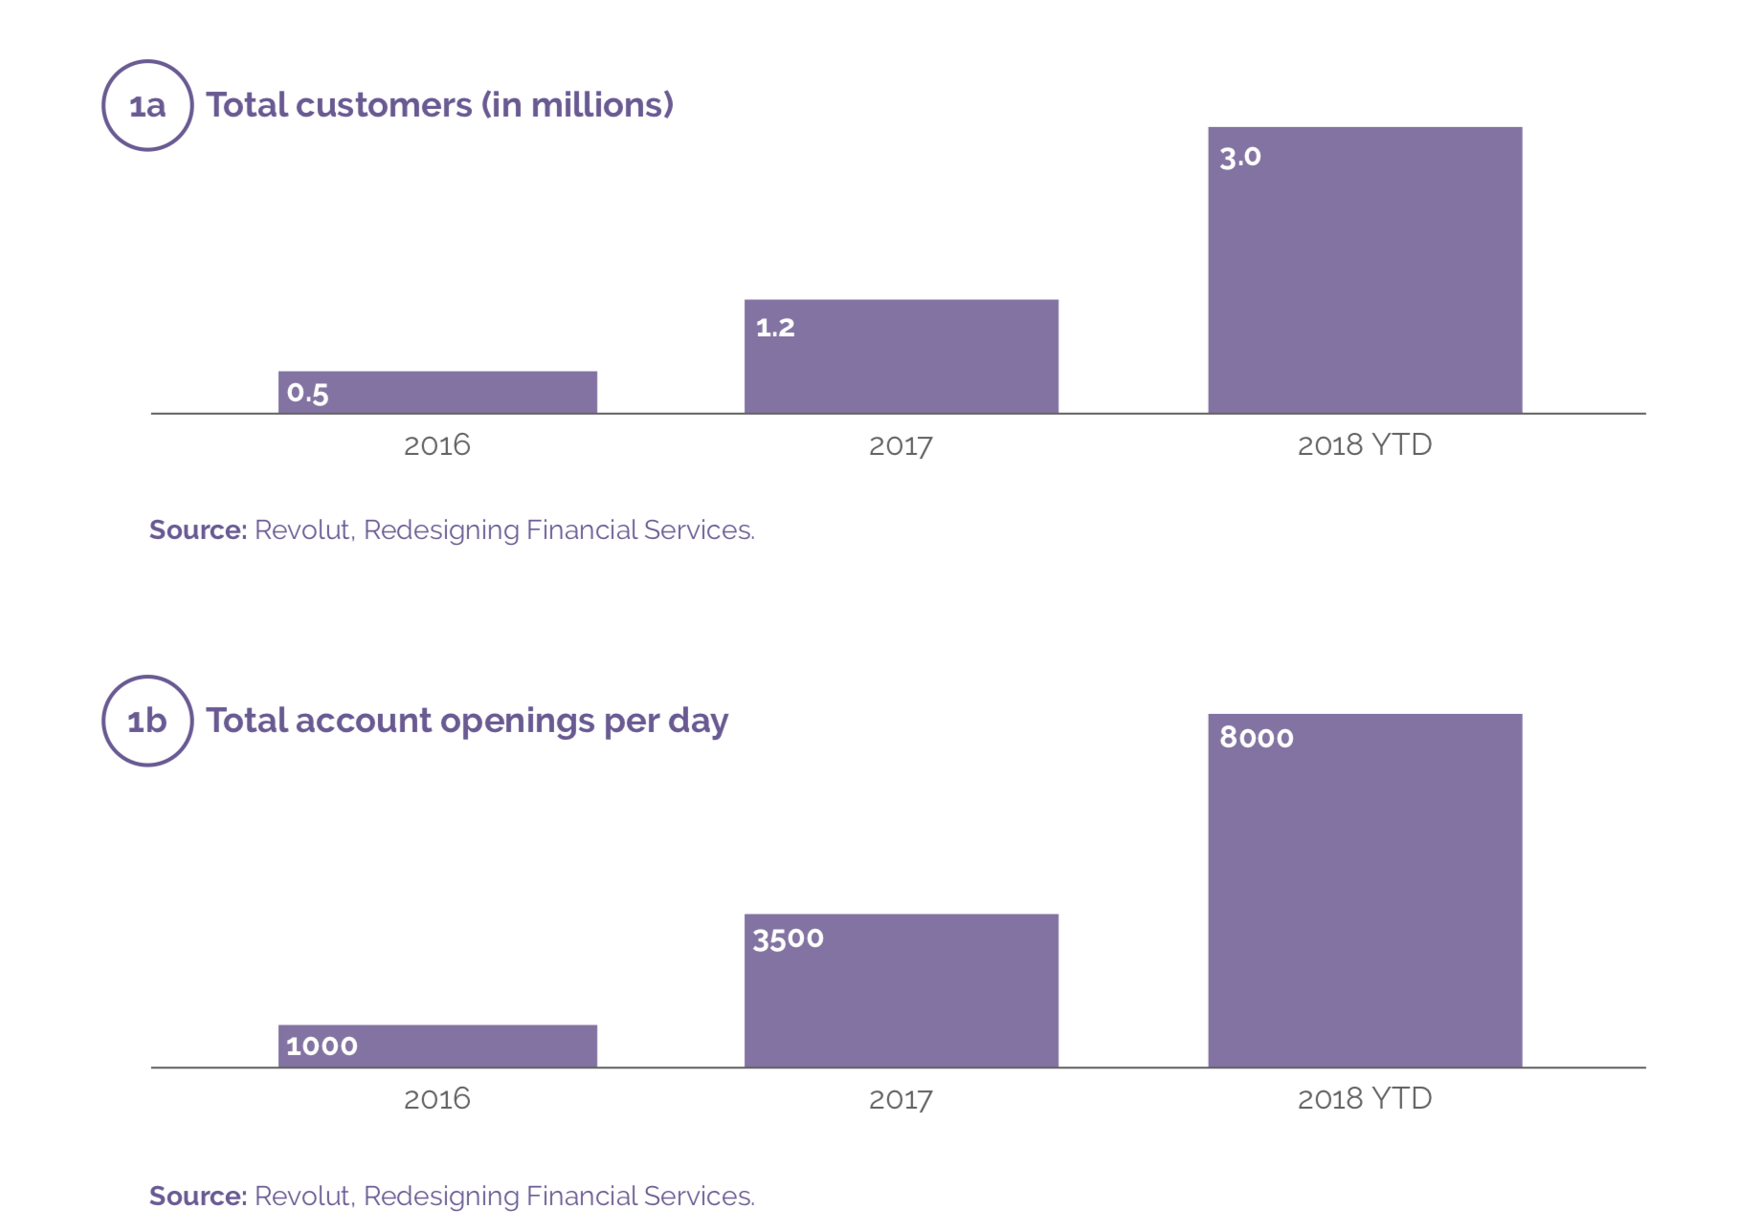

Slide 28
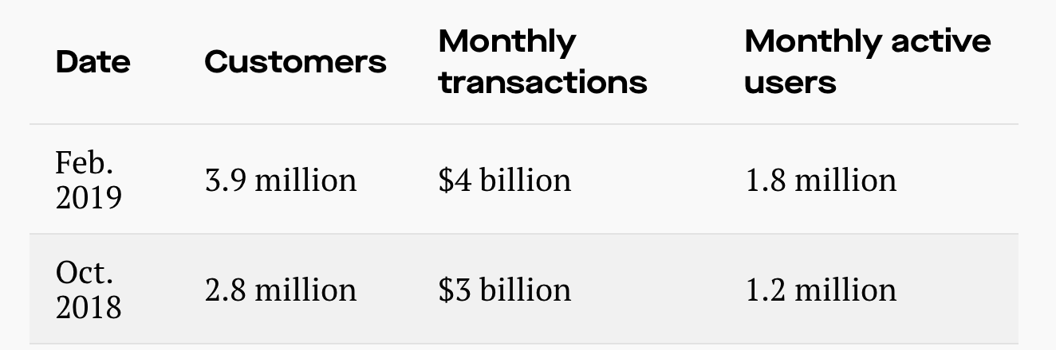
Source from https://qz.com/1541389/revolut-is-looking-to-raise-more-than-500-million-this-year/

Slide 29
Real Challenge
The biggest competitive threat is from tech giants like Apple, Amazon, Facebook and Google, since they have large amount of :
Customer Data
Capital
Employees
They can easily break into the banking space. It is also for this reason why Revolut is launching so many new services in addition to its original travel card functionality

Slide 30
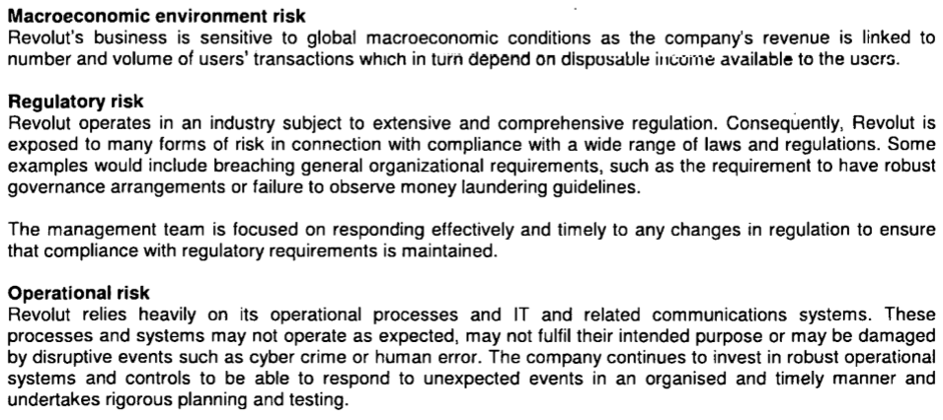

Slide 31
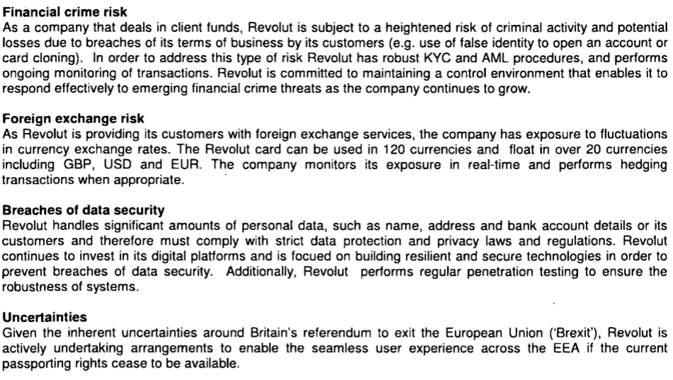

Slide 32
Hedging Foreign Exchange Risk
Forward Contracts
Future Contracts
Debt Operations
Swarp Contracts

Slide 33
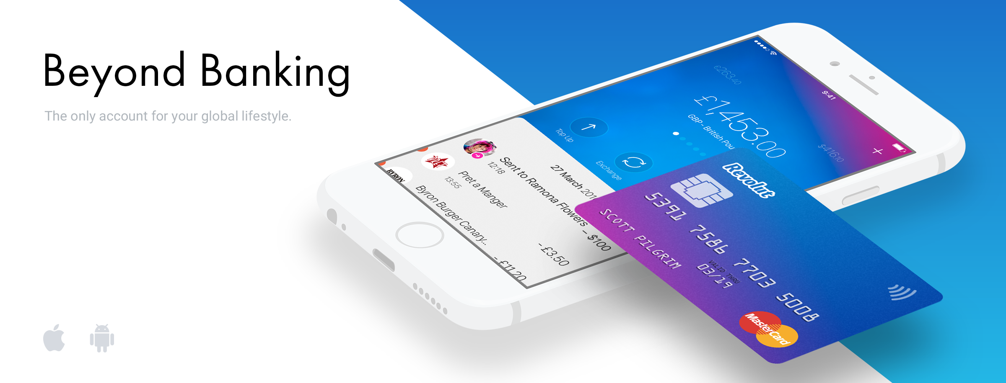
Revolut Pros
Can hold up to 24 different currencies in your account
Can purchase Cryptocurrencies
Spend abroad, avoiding poor exchange rates
24 Hour Customer Service via the website or live chat
User friendly App
Physical Card
Revolut Cons
When markets are closed at the weekend, fees are charged of 0.5% and 1% on currency exchange rates
Transaction over £5000 cost 0.5%
Free Cash withdrawals are limited to £200 per month
No physical bank branches

